Slide 1

FOOTBALL ANALYSIS:

Slide 2

Source Files :
Source File 1
Year
Match
Player Name
Club Name
Country Name
Appearances
Goals scored
Goals assist
Total shots
Shots on target
Fouls made
Fouls suffered
Yellow card
Red card
Goals saved
Goals conceded
Total penalty
Successful penalty
Salary
Source File 2
Year
Match Name
League Name
Club Name
Country Name
Appearances
Wins
Losts
Drawn
Clean sheets
Net Worth

Slide 3
The Dimension tables:
League
League ID
League Name
Club
Club_id
League_id
Club_Name
Manager
Owner
Country
Country_id
Country_Name
Coach
Match Type
Match_type_id
Match_Name
Player
Player id
player name
club_id
Country_id
position
Jersey number
D.O.B
nationality
Time
Time_id
Year
Quarter
Month

Slide 4
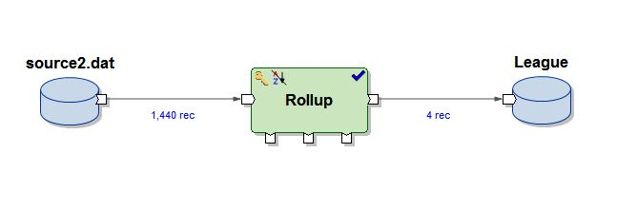
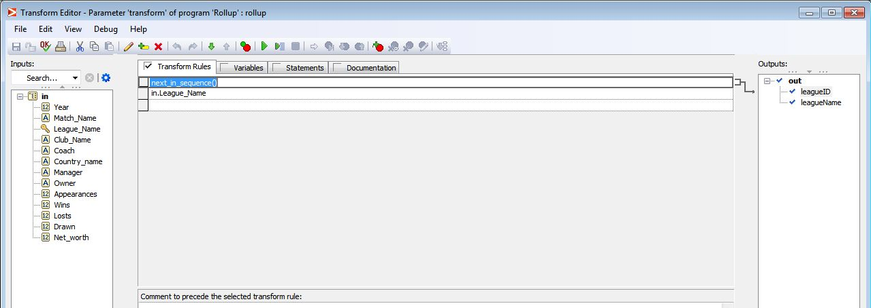
Dimension tables in Abinitio:
League:
Operation performed :

Slide 5
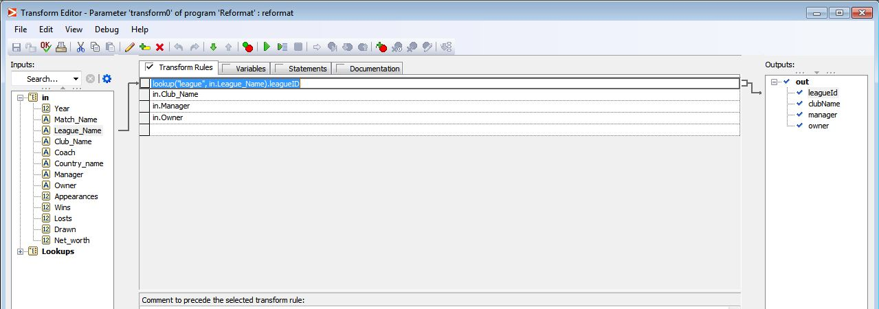
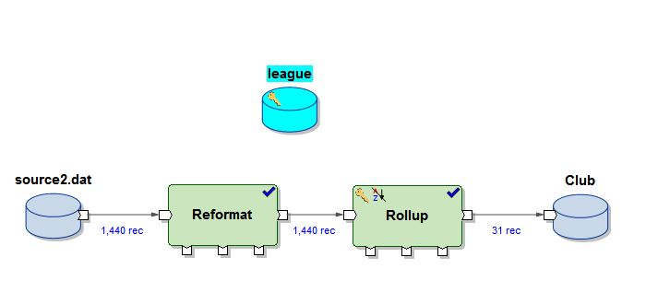
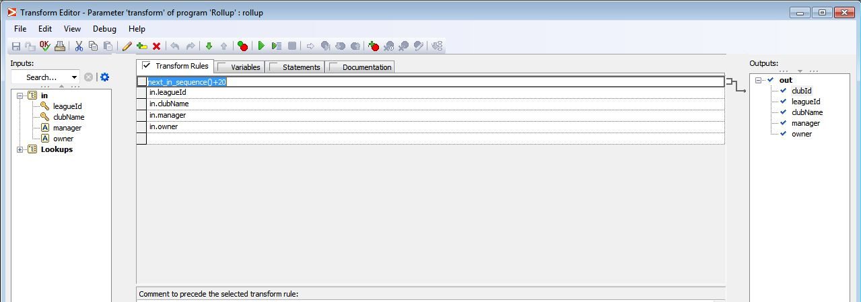
Dimension tables in Abinitio:
Operation performed :
Club:

Slide 6
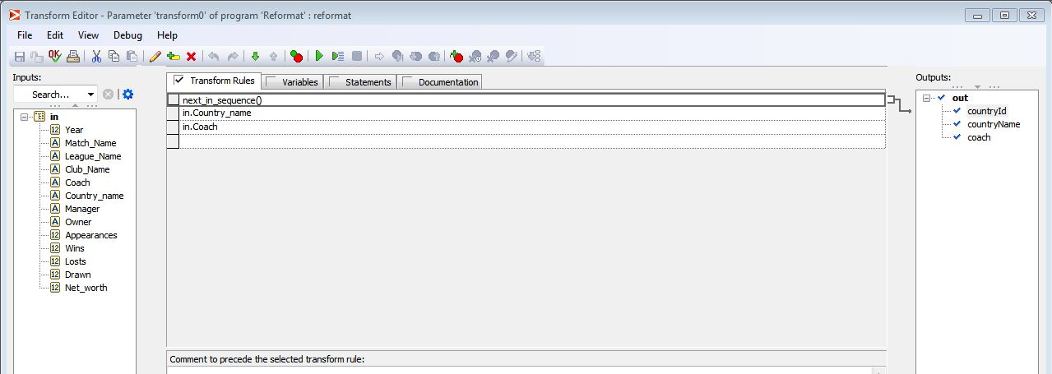
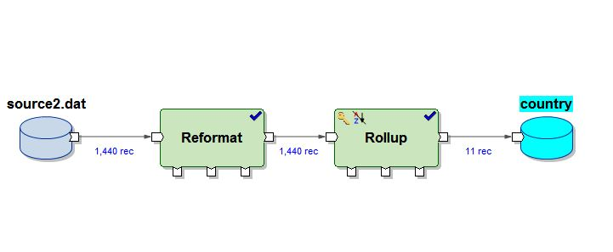
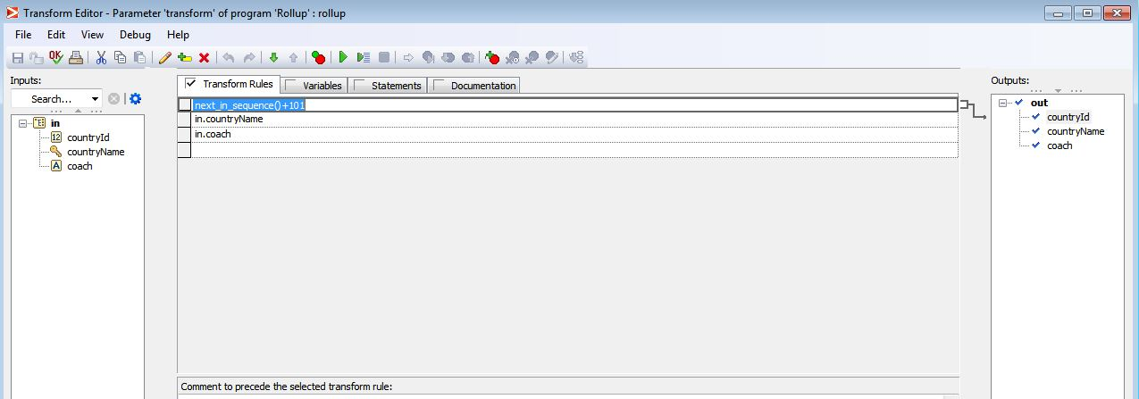
Dimension tables in Abinitio:
Operation Performed:
Country :

Slide 7
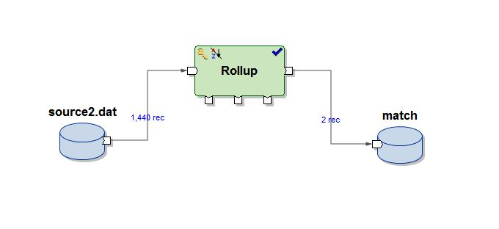
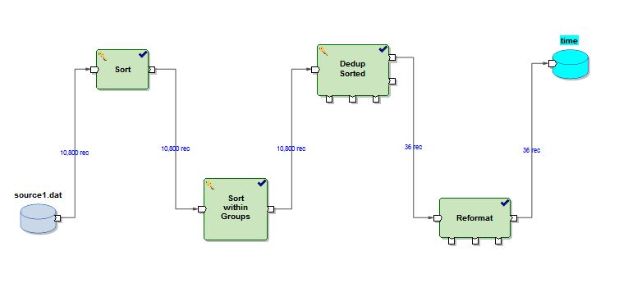
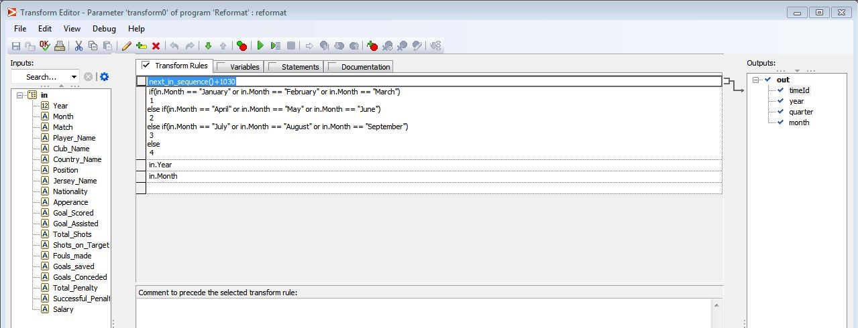
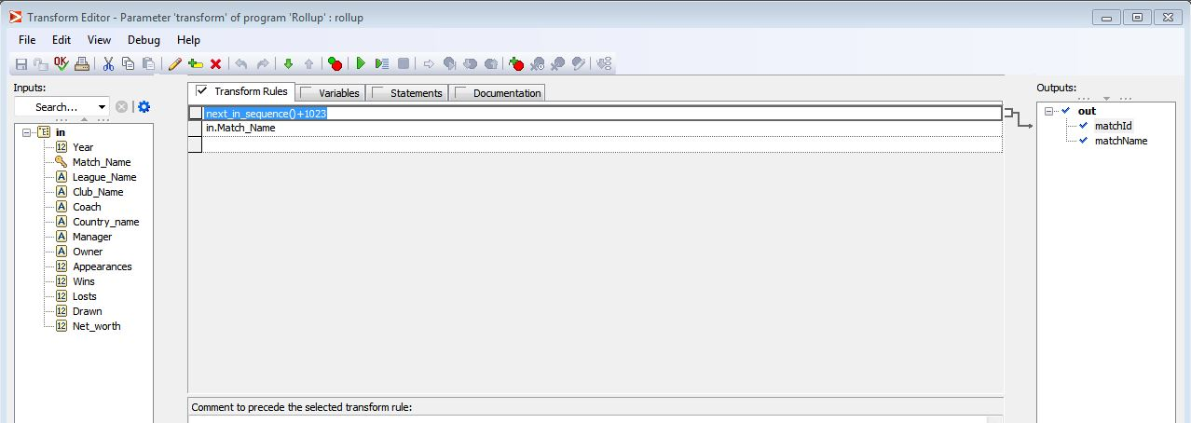
Dimension tables in Abinitio:
Match :
Time:
Operation Performed:

Slide 8
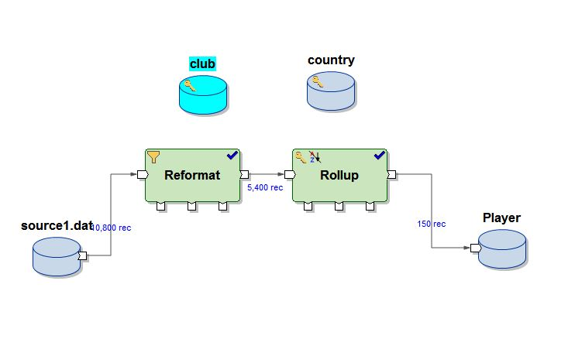
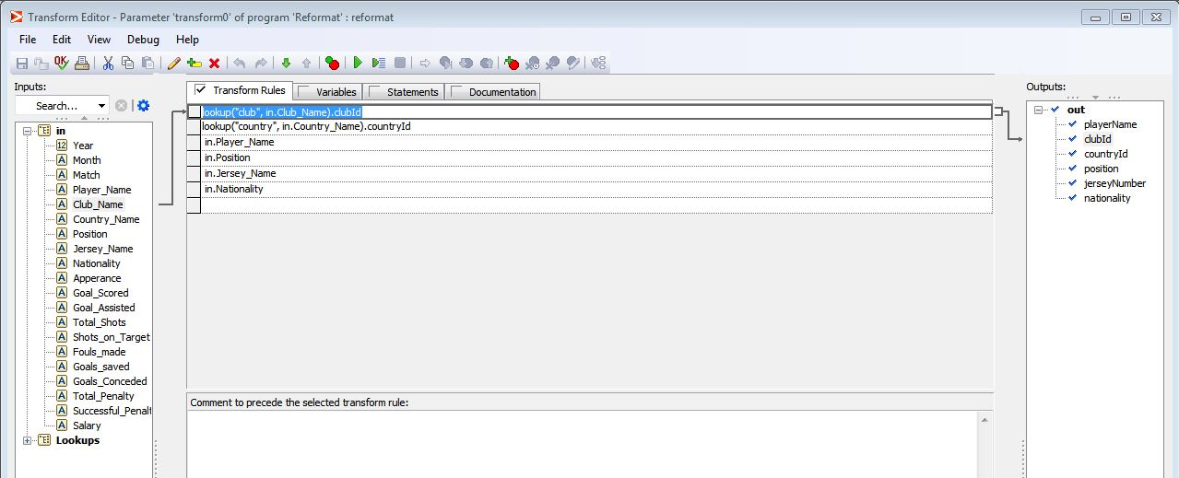
Dimension tables in Abinitio:
Player :
Operation Performed:

Slide 9
Fact Tables :
Fact Player Statistics :
Fact_id
Time_id
Match_type_id
Player_id
Club_id
Country_id
Appearances
Goals scored
Goals assist
Total shots
Shots on target
Fouls made
Fouls suffered
Yellow card
Red card
Goals saved
Goals conceded
Total penalty
Successful penalty
Salary
Fact Team Statistics :
Fact_id
Time_id
Match_type_id
League_id
Club_id
Country_id
Appearances
Wins
Lost
Drawn
Clean sheets
Net Worth

Slide 10
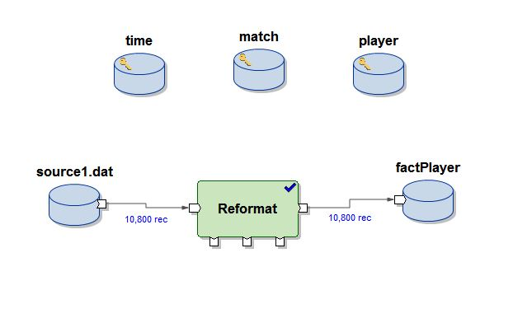
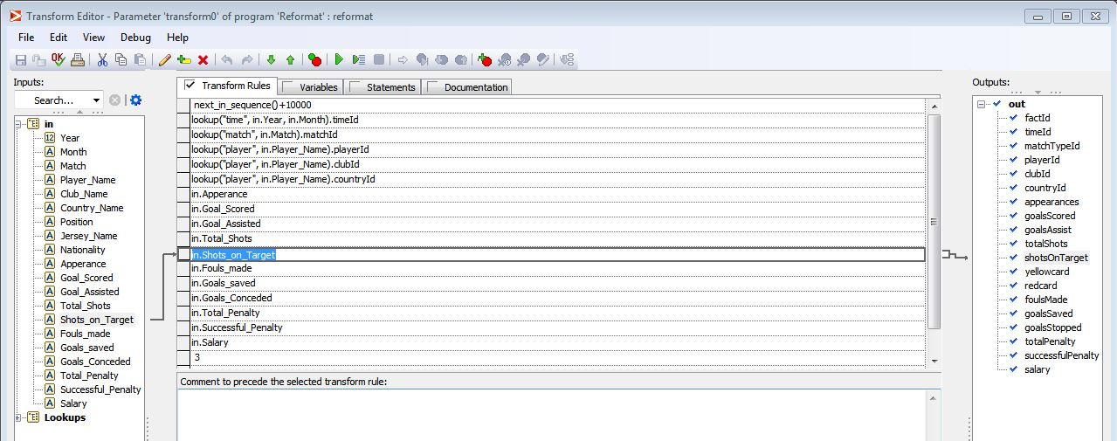
Fact Tables in Abinitio :
Fact Player :
Operation Performed :

Slide 11
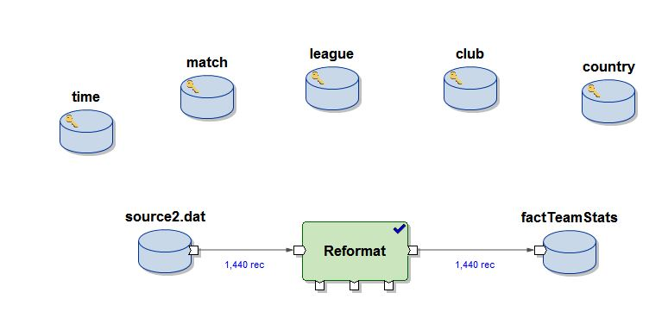
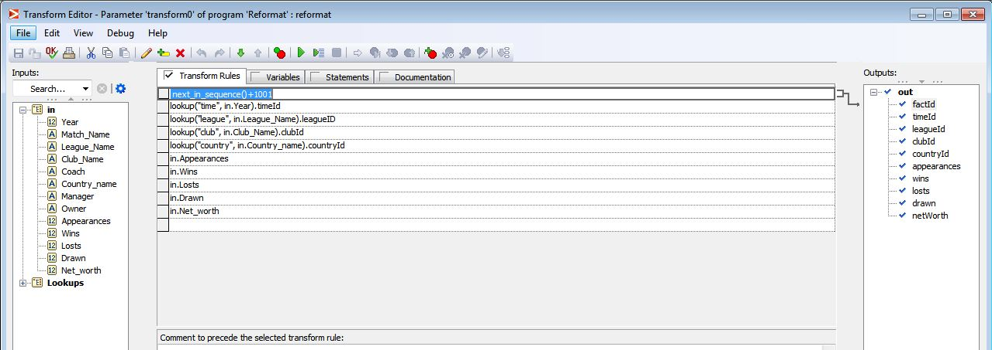
Fact Tables in Abinitio :
Fact Team Statistics:
Operation Performed :

Slide 12
SAMPLE REPORTS:

Slide 13
Top 10 attacking performers- Club :

Slide 14
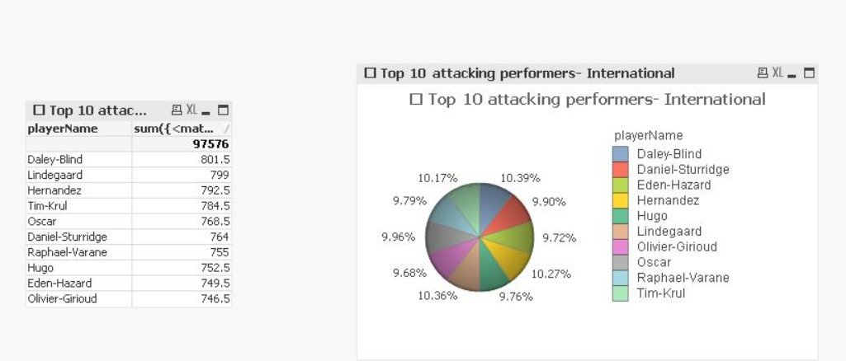
Top 10 attacking performers- International

Slide 15
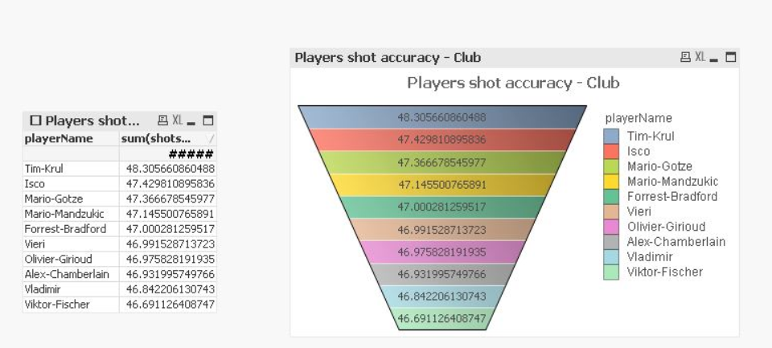
Players shot accuracy - Club :

Slide 16
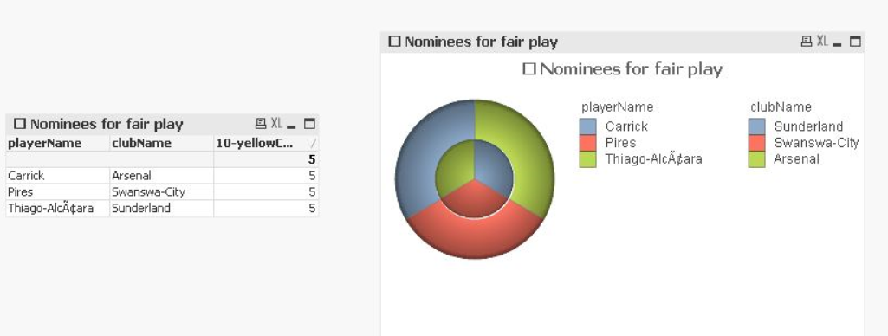
Nominees for fair play :

Slide 17
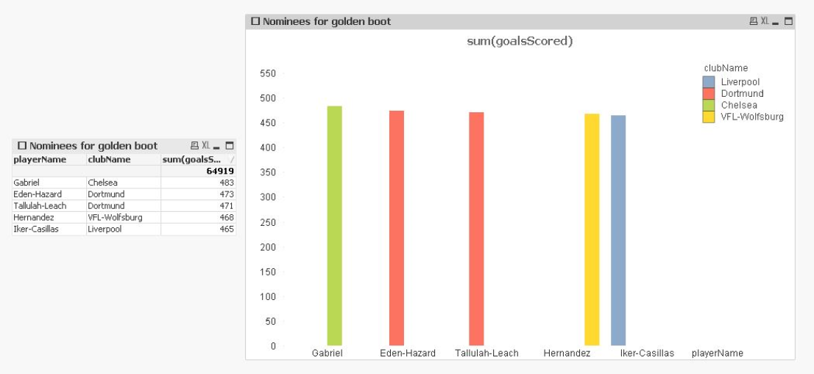
Nominees for golden boot :

Slide 18
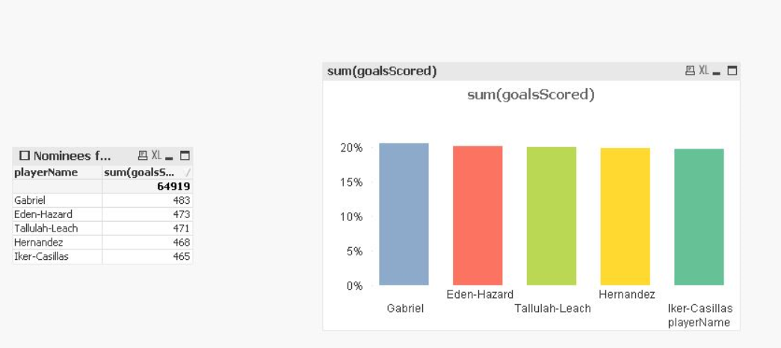
Nominees for golden ball :

Slide 19
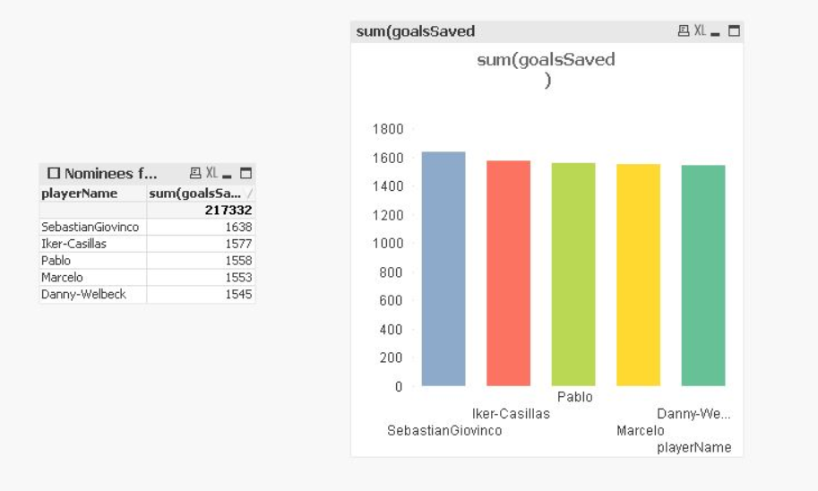
Nominees for golden glove :

Slide 20
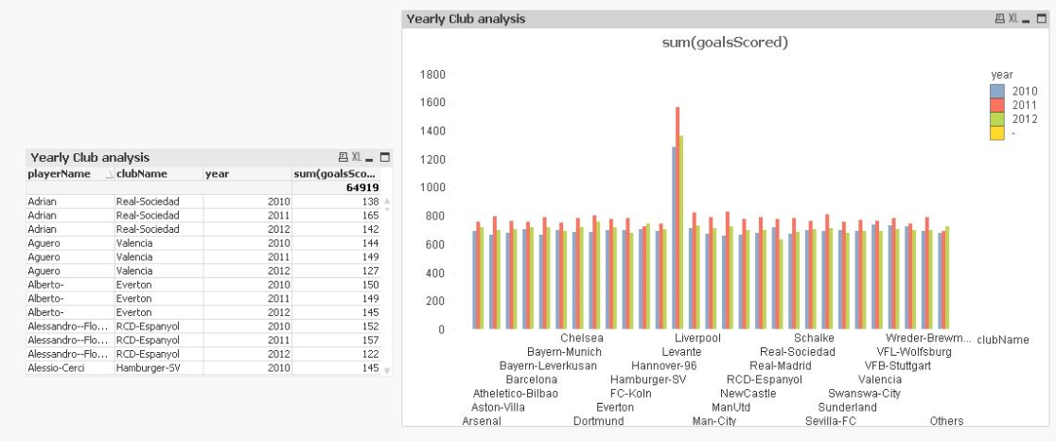
Yearly aggression analysis for each player – Respective Clubs :

Slide 21
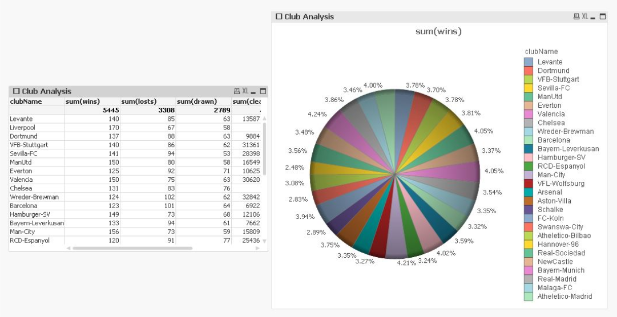
Club Analysis :

